Slide 1

Measuring data-driven changes
Only what I can measure changes

Slide 2
Stress.Performance.Platform
With the platform, Better linked offers for the first time the possibility - Getting stress out of the professional taboo zone!
With the offer of the Stress.Performance.Platform you offer your colleagues space: to share experiences, questions or personal experiences about stress, the effect and triggers of stress or changes in performance due to stress and learn from other users' solutions.
Better linked supports tips with self-coaching and ensures a trustworthy framework:
All users must register in order to use the platform.
Quality ensured – Clear Dos and Don‘ts
Communication on the platform is anonymous – Nickname

Slide 3

Fact based evaluation
Communication generates data, which is evaluated using AI (Natural Language Processing).
"Since we have the new system, I get all the difficult orders."
"My boss doesn't understand me, he always puts new documents on the table. I have already told him that the completion of the current projects needs my full attention at least until the end of the month. So new, urgent projects are out of place for me!"
"I have work until I drop, there is simply not enough time to complete all projects within the required time. I regularly receive new work orders from my boss, it's too much. But I don't dare to say 'NO'."
"I'm afraid to report that I'm still not familiar with the system and that's why I'm working so inefficiently."

Slide 4

Transformation and Change
Who is currently in a change project? Those who were not in change before Covid have been experiencing it at the latest since the outbreak of the pandemic. Work structure and processes are no longer as structured and organized as before, the workload has increased and has to be processed. Employees are missing.
What are the challenges behind the statements? Is it because of work organization? Is there a communication problem because the message has not arrived? Is it a relationship problem? Are processes, skills or IT tools missing? Is the task itself too time-consuming, so that it takes more time than expected?

Slide 5
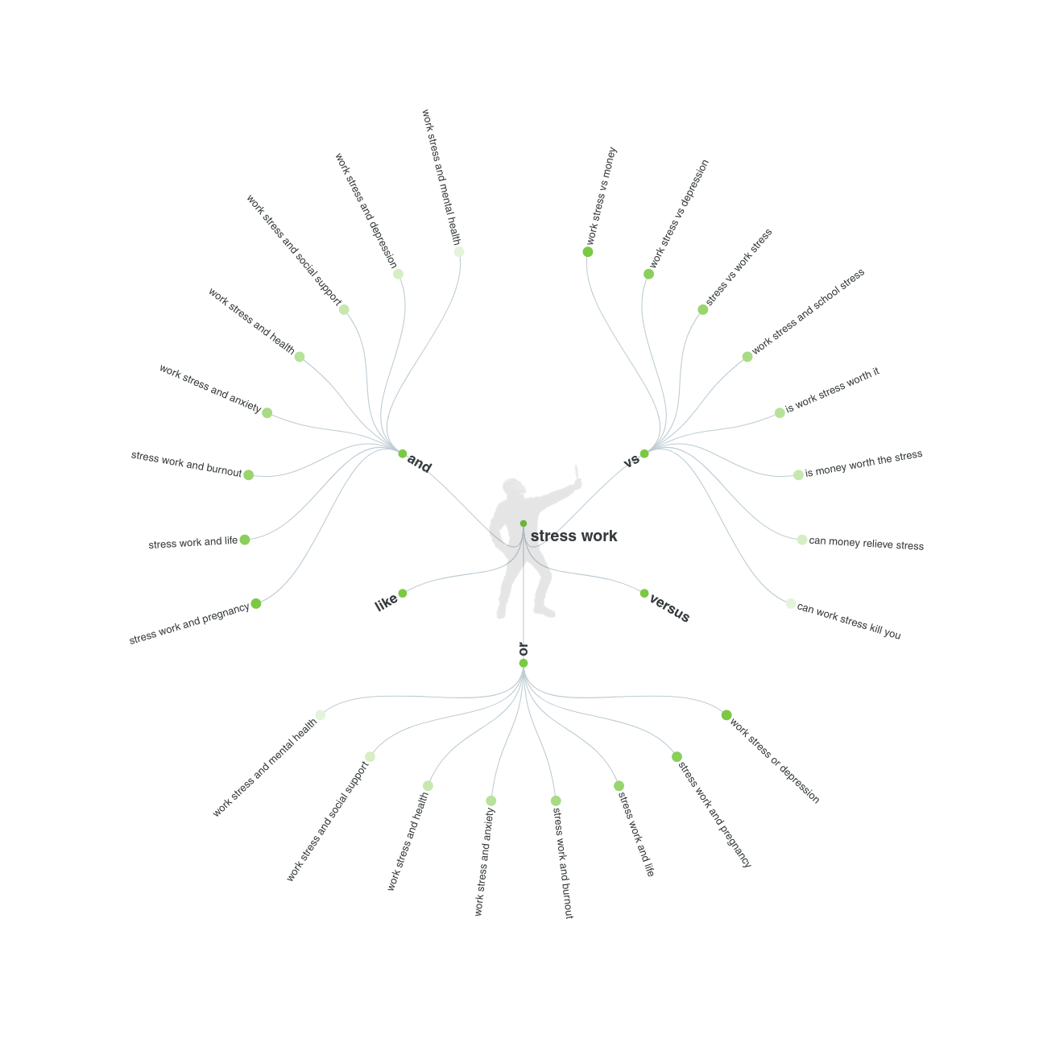
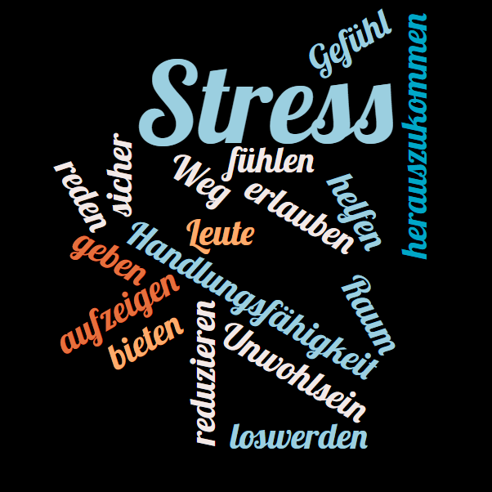
Project increase efficiency:
AI recognizes relationships,
causes and effects,
clusters and
dependencies:
Relevant problems are identified and accurately solved.

Slide 6
Was würden Sie in der Situation tun?
Perspektivenwechsel, das sagen andere Nutzerinnen:
Problemlösung anderer Nutzerinnen
Die wertvollsten Tipps der Community:
Nutzerinnenfeedback
Überstunden gemacht
Neue Projekte höher priorisiert und alte Projekte liegen gelassen
Sich Hilfe geholt von Kolleginnen
Ein persönliches Gespräch mit dem Chef vereinbart
Prioritäten verschoben, welche Teile meiner Arbeit sind wichtig, welche kann ich auch einmal weglassen, worauf konzentriere ich mich im Detail und was mache ich oberflächlich
Ein Spaziergang mit dem Chef
Ein gemeinsames Mittagessen, wir haben auch über Privates gesprochen
Motive des Chefs hinterfragt
Ich habe dem Chef gesagt was ich an ihm mag, aber auch was mich stört (Sandwich Gespräch)
An einem Teambuilding Workshop teilgenommen Ich habe mich getraut, nein zu sagen
Zu langsam
Umstrukturieren
Chef kann sich auf Dich verlassen
Jobwechsel
Nicht nein sagen können
Mehr Spezialisierung
Termindruck
Netzwerk an Unterstützerinnen
Chef hat selbst Druck
Auf ein Bier gehen

Slide 7

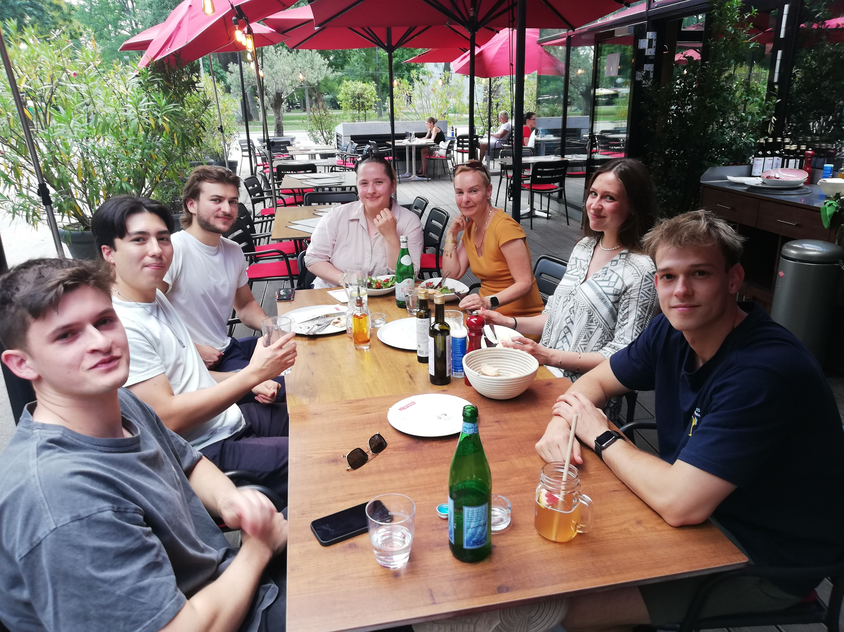
Network
Project partnership:
The Platform Better linked is supported by FFG-Impact Innovation (Österreichische Forschungsförderungsgesellschaft). (12/21-11/22)
Platform-development following Design Thinking Carola Wandres, Institut für Enterpreneurship & Innovation, Wirtschaftsuniversität Wien, SS 2022
Data analysis with NLP, Prof. Ronald Hochreiter, Wirtschaftsuniversität Wien, FIRM

Slide 8

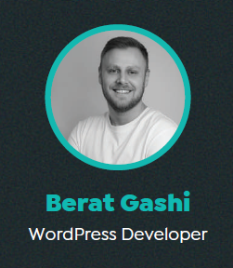
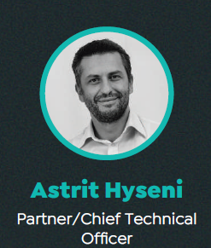
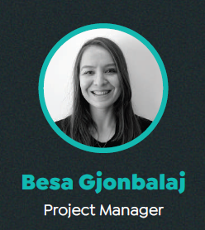
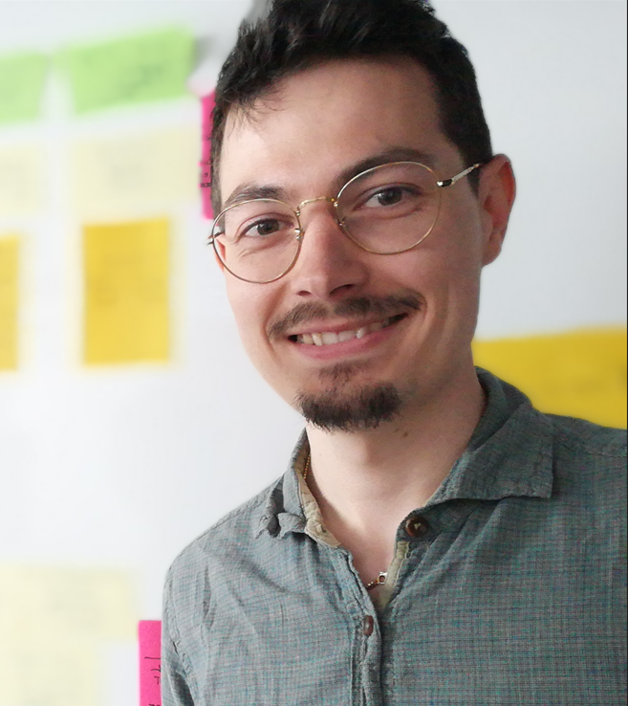

Core team
Programming/
Design
Rrota
Cornelia Perron Consulting
External data security advisor/
Data security consultant
Philip Toblier
Shift11
Prototyping

